Slide 1


Revisiting the Origins of the Italian Madrigal:
With Machine Learning
Julie E. Cumming
Cory McKay
SIMSSA Workshop XVII:
Infrastructure for Music Discovery
Montreal, QC, December 1, 2018

Slide 2
The origins of the madrigal
Current consensus
The madrigal emerges as a new genre of Italian-texted vocal music in the 1520s
The Italian-texted works by Verdelot are madrigals
It originated in Florence (and Rome?) in the 1520s
But where did it come from?
The frottola (Einstein 1949)
The chanson and motet (Fenlon and Haar 1988)
Florentine song: carnival song, and improvised solo song (A. Cummings 2004)

Slide 3
Finding the origins: what happened before Verdelot?
Verdelot arrived in Florence in 1521
Earliest sources of the madrigal
New focus: Florence, 1515-1522

Slide 4
My hypothesis
The madrigal was deliberately created as a
high-style genre of secular music
that emulates the style of the sacred motet
Why?
Musical sources
Texts
Musical style
Cultural context (not today)

Slide 5
What do sources tell us? Madrigals are the first Italian secular genre to be copied and printed in partbooks (previously used only for Masses and motets)
Prints
Motetti e Canzone I (Rome, 1520), partbooks
Pisano, Musica sopra le Canzone del petrarcha (Petrucci, Fossombrone, 1520) partbooks
Manuscripts
Florence 164 (c. 1522), partbooks
Chicago, Newberry Library (c. 1527) partbooks
Madrigals are called Canzone in the 1520s

Slide 6
What do sources tell us? Madrigals (Canzone) and motets are included in the same sources
Motetti e Canzone I (Rome, 1520), a lot of motets, a few madrigals
Florence 164 (c. 1522), madrigals, villotte and frottole, chansons, and motets
Chicago, Newberry Library (c. 1527); Verdelot madrigals and motets by many composers, including Verdelot

Slide 7
What do sources tell us? Madrigals are found in the first single-composer print for secular music (earlier single-composer prints are sacred Masses and laude)
Pisano, Musica sopra le Canzone del petrarcha (Petrucci, Fossombrone, 1520)

Slide 8
Similarities between madrigals and motets
Text: both are “high-style”serious genres
Latin-texted sacred music is at the top of the genre hierarchy (Tinctoris and Cortese)
Early madrigals set high-style Italian texts: mostly Petrarch, plus new texts
Form: both are through-composed, and avoid schematic repetition
Both have varied textures, including imitation and homorhythm

Slide 9
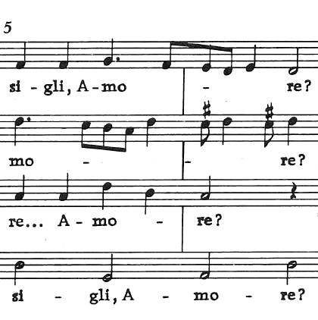
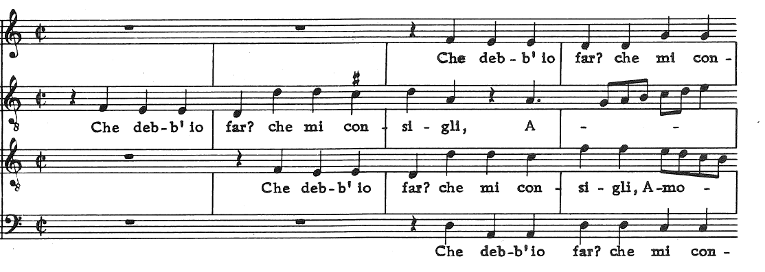
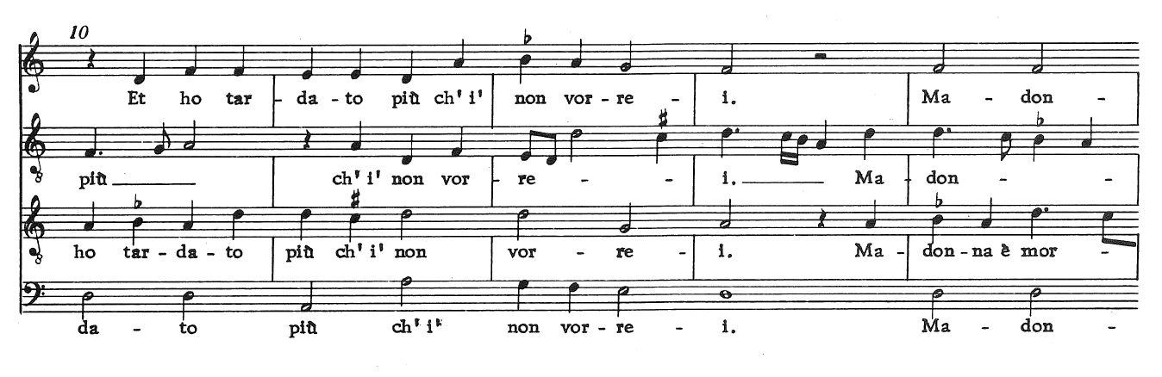
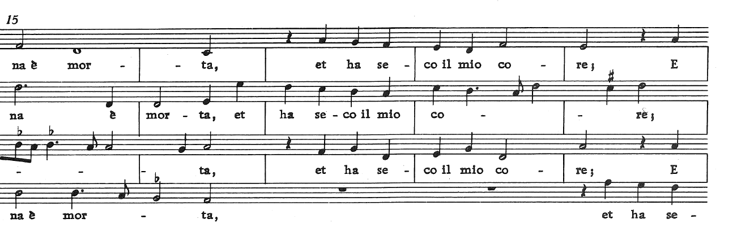
Imitation Cadence 4 vv.
6 measures omitted here
New material for “Madonna” – slower, sad; imitation/homorhythm, 3 vv
B. Pisano, Che degg’io far, Madrigal (from Pisano, Musica sopra le Canzone del petrarcha, 1520, and Florence 164, no. 12)
No schematic repetition, varied texture

Slide 10
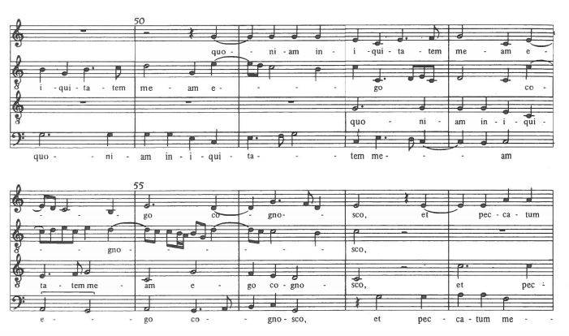
Carpentras, Miserere mei deus, F 164, n. 78
Imitation
Cadence, 4 vv. Imitation, 3 vv.

Slide 11
How can we test this hypothesis?
Compare the music of different genres
as understood during the period

Slide 12
Florence 164 (set of 4 partbooks); all for 4 voices Physical organization reveals genre distinctions between madrigals and other genres
Section divisions are shown by
gathering structure
blank pages between sections in partbooks
Part 1: 27 Madrigals
Part 2: 19 Villotte and Frottole
Part 3: 24 Chansons (not today)
Part 4: 12 Motets
No composer attributions; composer names are found in concordant sources

Slide 13
Florence 164, Part 1: 27 Madrigals
Part 1A: Pisano
14 secure Pisano
5 probably Pisano
Part 1B: Sebastiano Festa
5 secure Festa
2 probably Festa
Added to the end of the section slightly later
Anon. (maybe Festa)

Slide 14
Florence 164, Part 2: 19 pieces, 13 Villotte, 4 Frottole
4 “Northern proto-villotte” (arrangements of Italian popular tunes by northern composers, from c. 1500)
Isaac, Compere (Che fa la ramazina), Obrecht, Josquin (Scaramella)
6 Villotte (northern Italian polyphonic arrangement of a popular song)
3 Pesenti
2 F.P[atavino?]
1 S. Festa, 1 Anon.
3 anon. Zibaldoni (quodlibets; a subgenre of the villotta)
--------------------------
4 Frottole (2 Tromboncino; 2 Anon.)
1 Unclassified (anon.) (a voci pari; imitative; literary text)

Slide 15
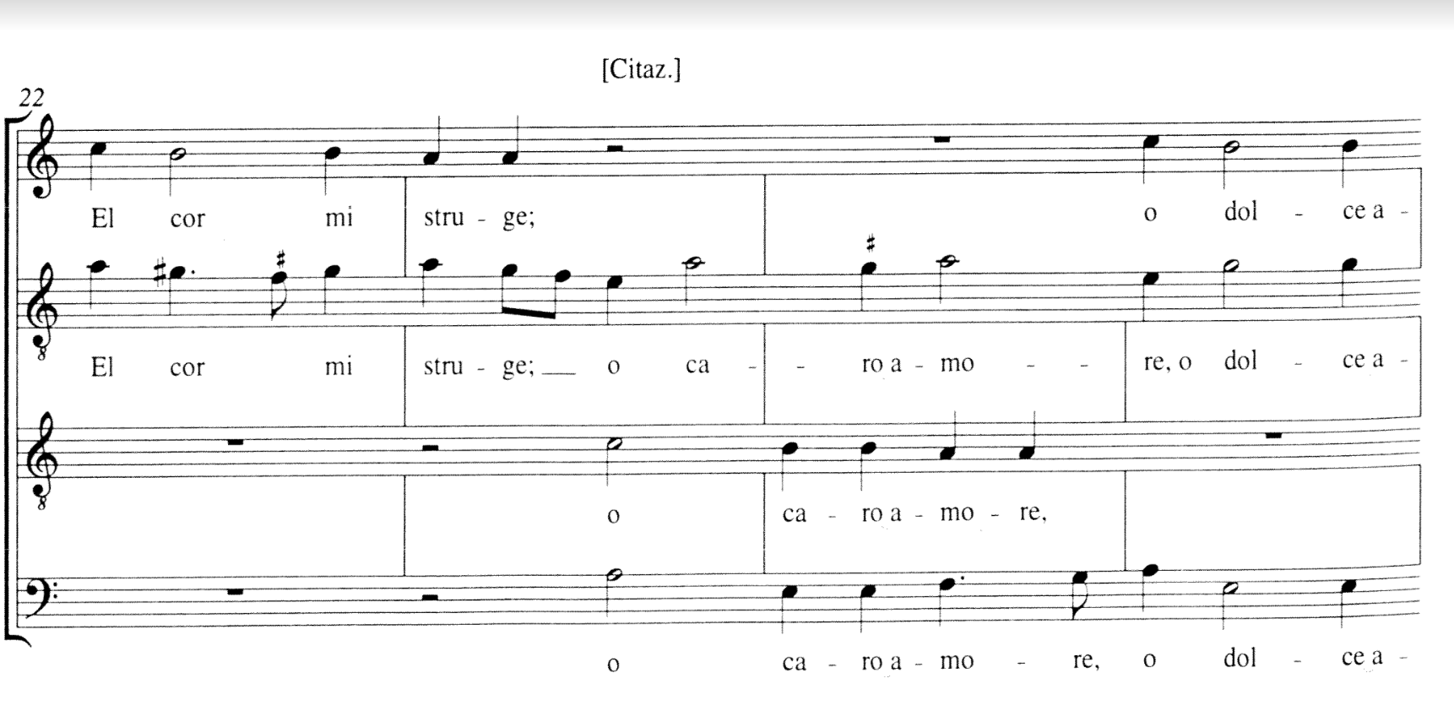
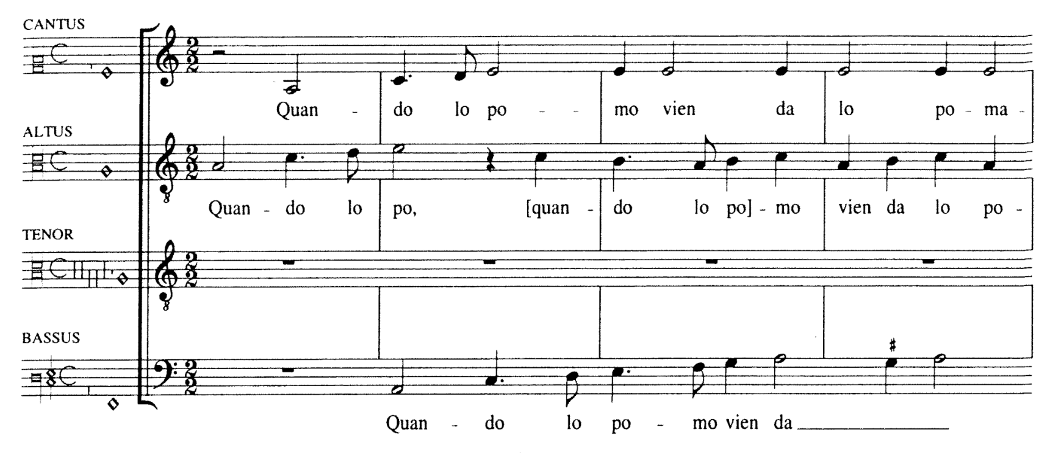
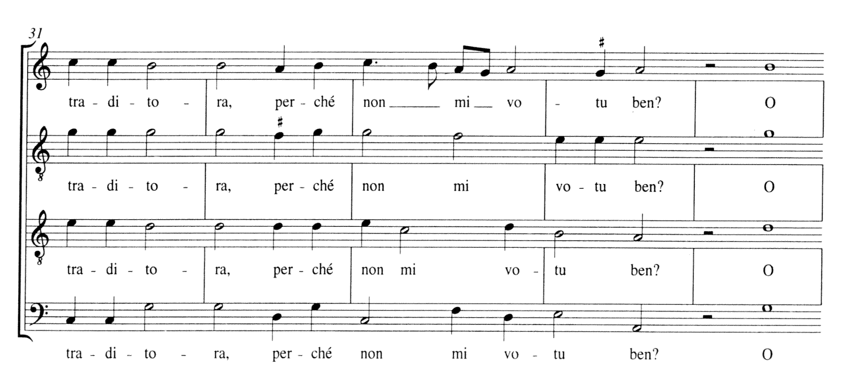
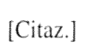
Pesenti, Villotta, Quando lo pomo (quotes “O traditora”); Florence 164, no. 32 Imitation and homorhythm; repeated notes; cites popular song in Tenor
Petrucci Frottole XI (1514)
Antico Frottole II (1516 or 1520)
Florence 230, 337, and 2440
Venice 10653-6

Slide 16
Florence 164, Part 4: 12 Motets
8 composed between 1485 and 1515
4 Josquin
3 Mouton
1 Isaac
4 composed c. 1515-20, composers associated with Medici popes in Rome
1 de Silva, 1 Carpentras (78)
2 Anon. (one may be by Medici Pope Leo X)

Slide 17
Genre classification – using the computer
How can we describe the differences between genres in terms that a computer can understand?
Extract musical features that can be quantified, with
jSymbolic 2.2, developed by Cory McKay
Text and text-setting are NOT considered in jSymbolic

Slide 18
What is a “feature”?
A piece of information that statistically characterizes a piece of music in a simple way
Usually has a numerical value
Can be a single value, or it can be a set of related values
Features can be automatically calculated by computers
From hundreds or thousands of pieces of music – or dozens!
Features can then be used to gain empirical insights:
Manually examined
Processed using statistical tools or machine learning, such as Weka

Slide 19
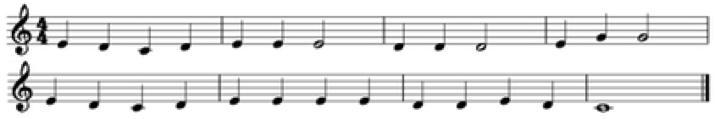
Example: Range
Range (Feature 1-D): Difference in semitones between the highest and lowest pitches
Range = G - C = 7 semitones
Notes:
Stress that very useful statistical information (i.e. other features) can be calculated from histograms, especially their peaks.

Slide 20
Example: Pitch Class Histogram (set of related values
Pitch Class Histogram (Feature 12-D): values represent the percentage of notes with a particular pitch class
Pitch Class Histogram: see graph
Note counts: C: 3, D: 10, E: 11, G: 2
Most common note: E (11/26 notes)
Corresponding to 0.423 of the notes
E G C D
Notes:
Stress that very useful statistical information (i.e. other features) can be calculated from histograms, especially their peaks.

Slide 21
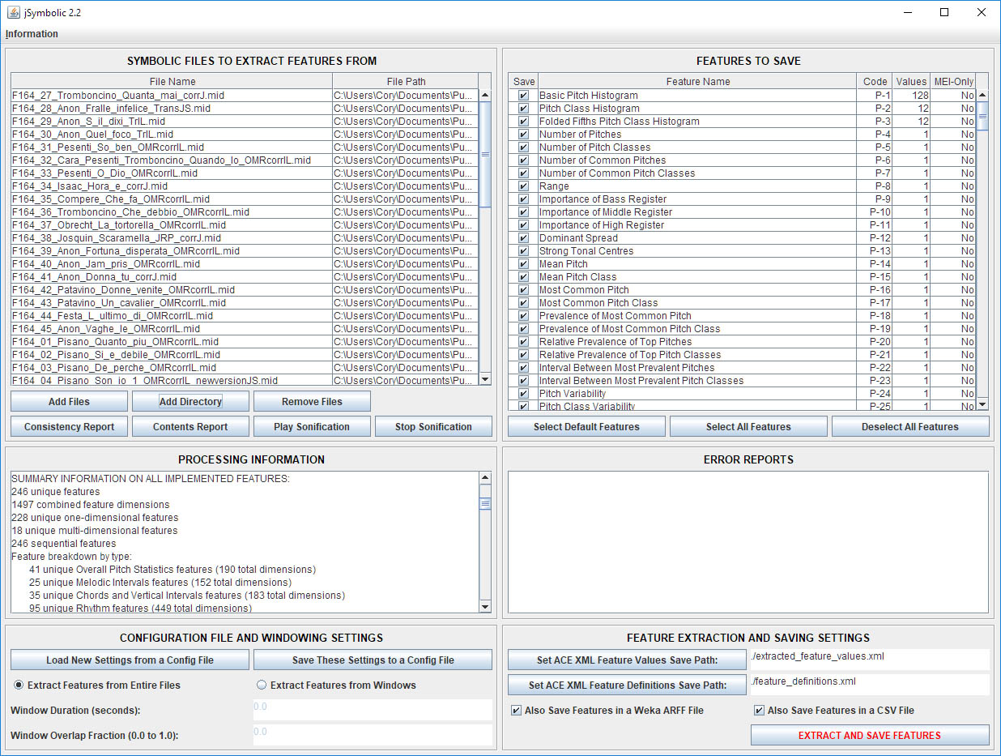
jSymbolic 2.2
Software produced to automatically extract features
And develop new features
In all, extracts a total of 1497 separate feature values
Pitch statistics
Melody + Horizontal intervals
Chords + Vertical intervals
Rhythm
Texture
Dynamics
Instrumentation

Slide 22
jSymbolic 2.2
More information (http://jmir.sourceforge.net )
MedRen 2017: “Using Statistical Feature Extraction to Distinguish the Styles of Different Composers”
ISMIR 2018: “jSymbolic 2.2: Extracting Features from Symbolic Music for use in Musicological and MIR Research”

Slide 23
Our experiment: pieces from F 164
Began by constructing our dataset, consisting of 58 MIDI files:
Extracted features from each of these pieces using jSymbolic
Excluded features not relevant to this corpus
Associated with tempo, dynamics, instrumentation, etc.
801 feature values were extracted per piece
Genre | Pieces
Pt. 2: Villotte&frottole | 19
Pt. 1: Madrigals | 27
Pt. 4: Motets | 12

Slide 24
Methodology
Used machine learning to teach a classifier to automatically distinguish the music belonging to each of the genres
Based on the jSymbolic features
Using Weka’s SMO SVM implementation

Slide 25
Genre Classification results
Genre Group | Classification Accuracy
Villotte&frottole vs. Madrigals vs. Motets | 68.4%
Villotte&frottole vs. Madrigals | 64.6%
Villotte&frottole vs. Motets | 84.8%
Madrigals vs. Motets | 99.1%

Slide 26
First set of experimental conclusions
The madrigals and motets are the most different genres
Because they can be easily distinguished with features and machine learning (99.1% success rate)
Villotte&frottole and madrigals are the most similar genres
Because they are harder to tell apart (only 64.6% success rate)
Villotte&frottole and motets are in between (84.8% success rate)
More similar than motets and madrigals
But less similar than villotte&frottole and madrigals

Slide 27
Caveats
There are relatively few pieces in the dataset (58)
Statistical patterns found in this dataset may not necessarily generalize to all relevant music in the three genres
There are relatively few composers represented (12 & 10 anon.)
Detected patterns may be linked to differences in composers’ compositional style rather than genre
Nonetheless, the results are certainly meaningful within the scope of this study

Slide 28
But how do the genres differ?
We can look at particularly important specific feature values . . .

Slide 29
A priori expectations (1/3)
What characteristics might an expert musicologist (Julie Cumming) expect to differentiate the genres?
Before actually examining the feature values
Once formulating these expectations, we can then see if the feature data confirms or repudiates these expectations
Both are useful!

Slide 30
A priori expectations (2/3)
What do you think might distinguish the three genres?
Villotte&frottole vs. Madrigals vs. Motets
According to our (a priori) expectations . . .

Slide 31
A priori expectations (3/3)
Length of piece?:
V&f shortest, then Madrigals, Motets longest
Melodically repeated pitches:
Motets fewer; V&f + Madrigals more
Variation in range between voices:
V&f more variety; Madrigals + motets less
Variation in size of melodic leaps per voice:
V&f more variety; Madrigals + motets less
Variation in number of notes per voice:
V&f more variety; Madrigals + motets less
Number of voices sounding simultaneously:
V&f mostly 4; Motets mostly 1 to 3; Madrigals a mix of both

Slide 32
Were our expectations correct?
Length of piece:
V&f shortest, then Madrigals, Motets longest YES (strongly)
Melodically repeated pitches:
Motets fewer; V&f + Madrigals more YES
Variation in range between voices:
V&f more variety; Madrigals + motets less PARTLY
Variation in size of melodic leaps per voice:
V&f more variety; Madrigals + motets less YES
Variation in number of notes per voice:
V&f more variety; Madrigals + motets less NO
Number of voices sounding simultaneously:
V&f mostly 4; Motets mostly 1 to 3; Madrigals a mix of both PARTLY

Slide 33
Expectations vs. reality
Variation in range between voices:
Expectation: V&f more variety; Madrigals + motets less
Reality: V&f + motets more variety; Madrigals less
Variation in number of notes between voices:
Expectation: V&f more variety; Madrigals + motets less
Reality: Motets (much) more variety, then Madrigals, V&f least variety
Number of voices sounding simultaneously:
Expectation: V&f mostly 4; Motets mostly 1 to 3; Madrigals a mix of both
Reality: V&f and Madrigals mostly 4; Motets mostly 3

Slide 34
(Free) diving into the feature values
We can also explore the feature data to see if it reveals unexpected insights as to which features are particularly effective
Based purely on the data itself, not on our expectations
We used ten statistical techniques to find the features most consistently statistically effective at distinguishing the genres
We then manually examined these feature subsets to find the features likely to be the most musicologically meaningful

Slide 35
Novel insights revealed (1/3)
Madrigals vs. motets (99.1%):
Rhythm-related features are extremely powerful
In particular:
Half notes (minims) and eighth notes (fusae) are both much more common (relative to other rhythmic values in a given piece) in madrigals
Series of notes of the same rhythmic value in a voice tend to be longer overall in madrigals, and also vary more in the number of notes in each series
Motets have more long notes (breves and longs)

Slide 36
Novel insights revealed (2/3)
Villotte&frottole vs. madrigals (64.6%):
The differences are less pronounced, but there are still certain patterns, especially relating to rhythm
Details:
Madrigals tend to have a greater difference between the shortest and longest note durations in a piece
Madrigals tend to have longer note durations in the lowest voice (relative to durations in other voices in the same piece)
The minimum rhythmic value in a piece tends to be shorter in madrigals

Slide 37
Novel insights revealed (3/3)
Villotte&frottole vs. motets (84.8%):
Features based on rhythm (and texture) dominate
Details:
Note density is important once again:
Motets tend to have a much lower note density in the highest voice
The most common rhythmic value tends to be longer in motets
Rests are particularly significant:
Motets tend to have more rests in general
In particular, motets tend to have more points where at least one voice is silent while at least one other is sounding

Slide 38
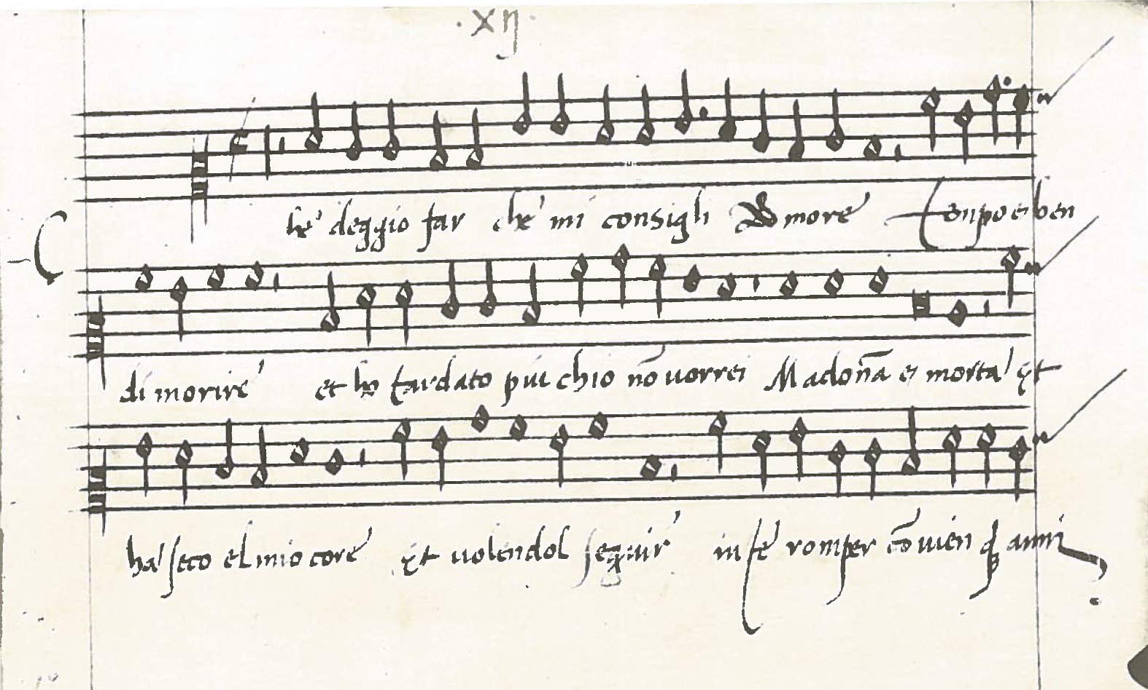
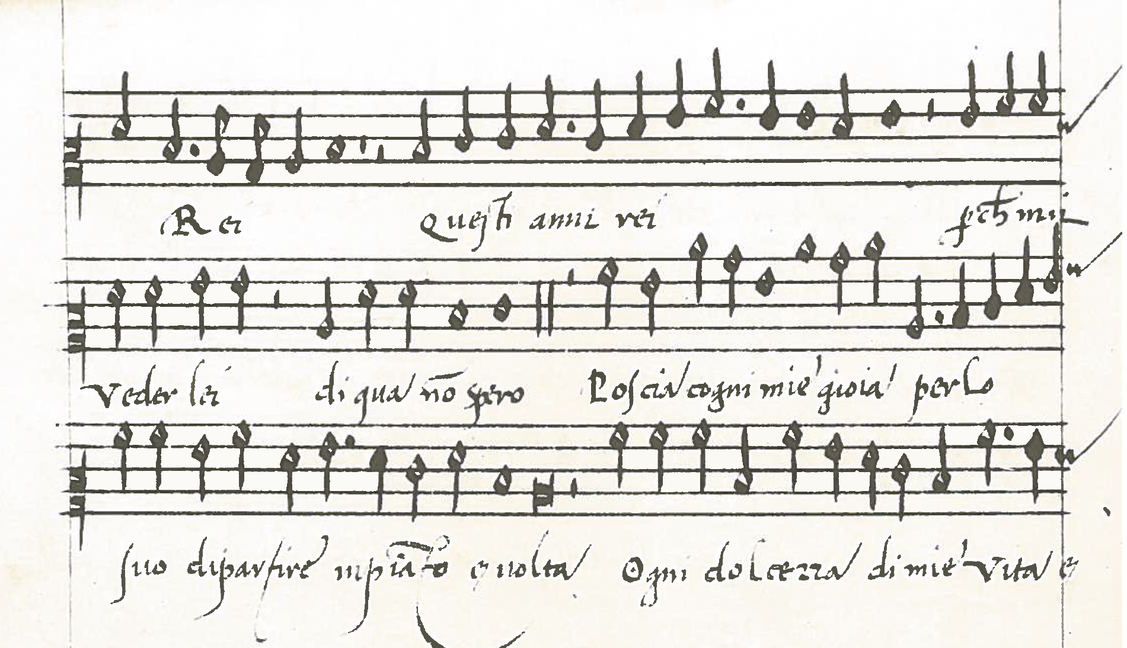
Madrigal, B. Pisano, Che deggio far, cantus Florence 164 no. 12 (madrigal section)

Slide 39
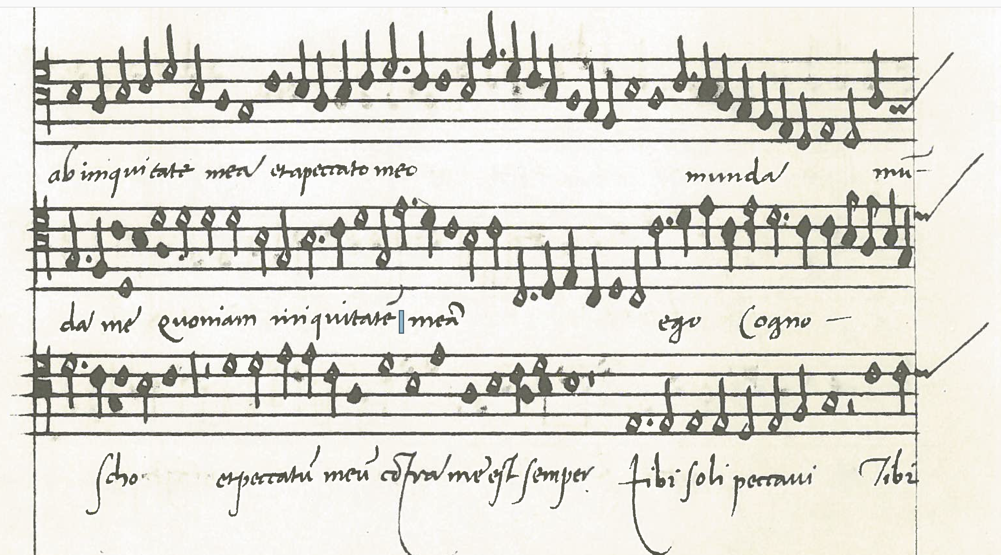
Carpentras, Miserere mei deus, F 164, n. 78 Altus (pt. 4, motets)

Slide 40
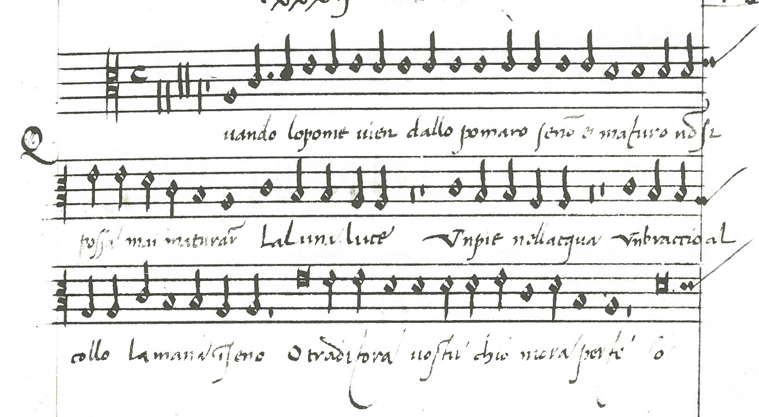
Pesenti, Villotta, Quando lo pomo, Florence 164, no. 32 (villotta and frottola section), altus

Slide 41
Caveats
The madrigal does share some features with the motet – which lend themselves to the “high style”
Madrigals are longer than other secular Italian genres
All voices are similar in terms of the size of leaps; i.e. melodic style
The motets mostly earlier than madrigals (affecting ranges, rhythm); a better comparison set might be later motets
Some of the similarities between madrigals and motets (such as imitation) are things that jSymbolic does not yet include as features
Many of the differences are related to text-setting practices for Italian and Latin

Slide 42
What did we learn?
The particular musical characteristics an expert might think differentiate the genres are generally correct, but not perfect
Rhythm is a key feature in genre identification

Slide 43
What does jSymbolic tell us about the origins of the madrigal?
I was wrong about many of the similarities between the madrigal and motet – they are very different
The villotta emerges as an important genre for the origins of the madrigal – even though it has almost never been considered in this role before
Cory’s jSymbolic has forced me to reconsider my hypotheses, and taught us a great deal about a key moment in music history

Slide 44
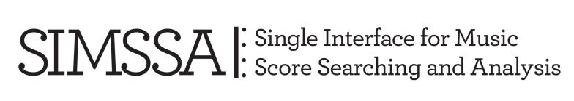



Thanks to:
Ian Lorenz, Jonathan Stuchbery, and Vi-An Tran, for creating our symbolic corpus
Zoey Cochran, for her ideas on the early madrigal
Florentine libraries: the Biblioteca Nazionale Centrale and the Conservatorio di Musica Luigi Cherubini

Slide 48
Our corpus: 12 composers, + 10 anon. pieces
Section: | 1) Madrigal | 2) V&F | 4) Motet | Total
Pisano | 19 |  |  | 19
Festa, S. | 7 | 1 |  | 8
FP |  | 2 |  | 2
Pesenti |  | 3 |  | 3
Tromboncino |  | 2 |  | 2
Anon | 1 | 7 | 2 | 10
Compere |  | 1 |  | 1
Obrecht |  | 1 |  | 1
Isaac |  | 1 | 1 | 2
Josquin |  | 1 | 4 | 5
Mouton |  |  | 3 | 3
Carpentras |  |  | 1 | 1
de Silva |  |  | 1 | 1
 | 27 | 19 | 12 | 58

Slide 49
The First Madrigalists: Composers whose music is found in Florentine manuscripts
Bernardo Pisano (1490-1548)
Trained in Florentine churches: the Duomo and Santa Annunziata
Chapel master of the Duomo, 1512
Also works with the Papal chapel in Rome under Leo X, 1514
Sebastiano Festa (c. 1490-1524)
Active in Rome, connected with court of Leo X (Medici pope)
Philippe Verdelot (c. 1480-c. 1530?), French composer
Venice (according to Vasari), then Rome in 1510s
Arrives in Florence, 1521 (probably dead by 1530)

Slide 50
Can we distinguish these genres in F164?
Genre (style height) Text (all Italian unless noted) | Dates of genre
Motet (high, serious) Latin, sacred; Psalms, prayers, bible, liturgy | 1480 to 1520 (continues)
Frottola (middling; popular or serious) Popular to Petrarch; fixed forms, many stanzas | 1490 to 1520
Northern proto-villotta (low; popular) Popular song texts and melodies | 1490 to 1510
Villotta (low; popular) Northern dialect, quotes popular song, often obscene | 1510 to 1530
Madrigal, Pisano & S. Festa (high; serious) Petrarch and high-style new poetry | 1515-1525 (continues)

Slide 51
Can we distinguish these genres in F164?
Genre (style height) Text (all Italian unless noted) | Dates of genre
Motet (high, serious) Latin, sacred; Psalms, prayers, bible, liturgy | 1480 to 1520 (continues)
Frottola (middling; popular or serious) Popular to Petrarch; fixed forms, many stanzas | 1490 to 1520
Northern proto-villotta (low; popular) Popular song texts and melodies | 1490 to 1510
Villotta (low; popular) Northern dialect, quotes popular song, often obscene | 1510 to 1530
Madrigal, Pisano & S. Festa (high; serious) Petrarch and high-style new poetry | 1515-1525 (continues)

Slide 52
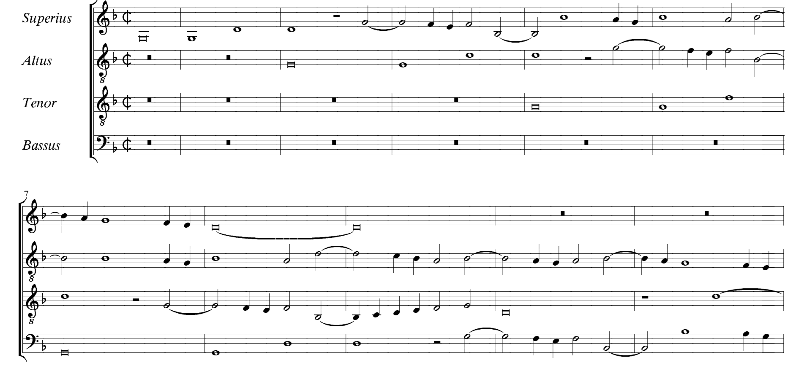
Motet by Josquin Desprez, Missus est Gabriel angelus (F164 no. 79, from the JRP)
Imitation; wide ranges; variety of note values; few repeated notes, melismatic

Slide 53
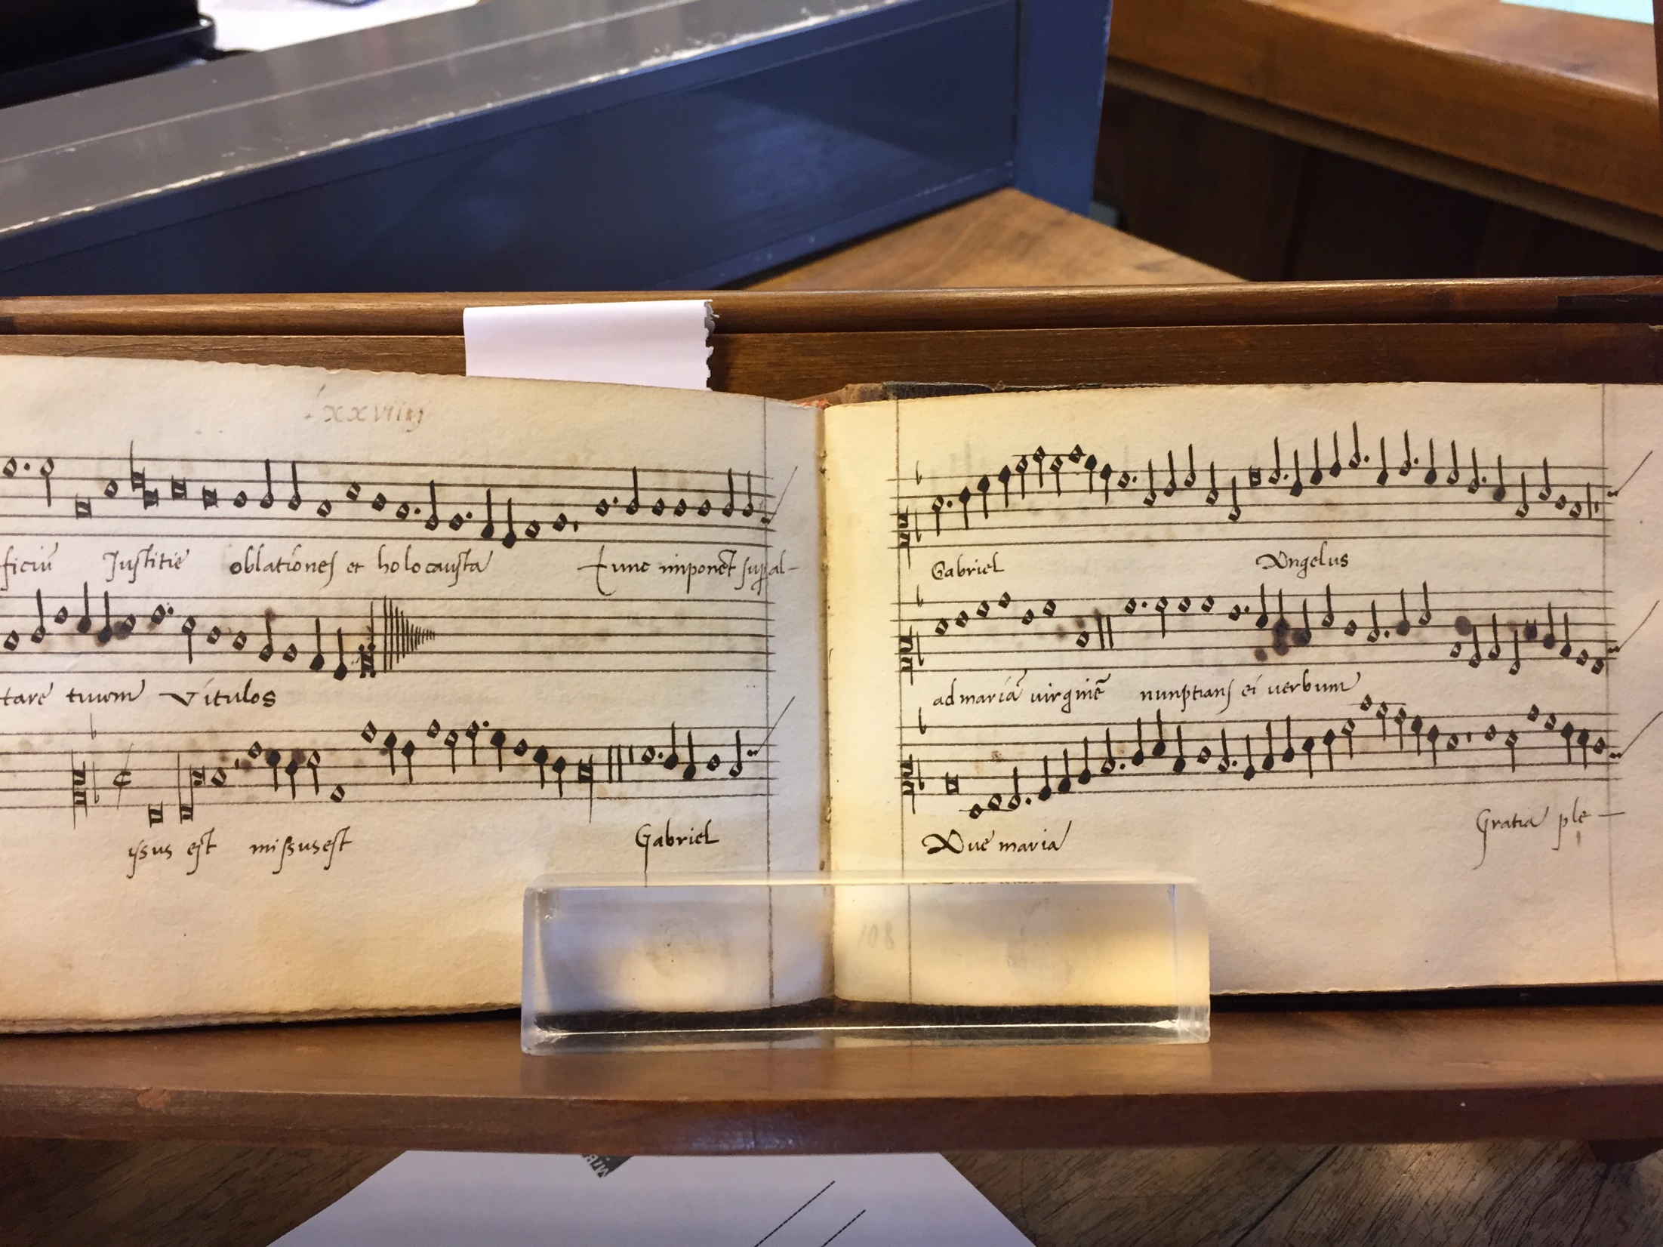
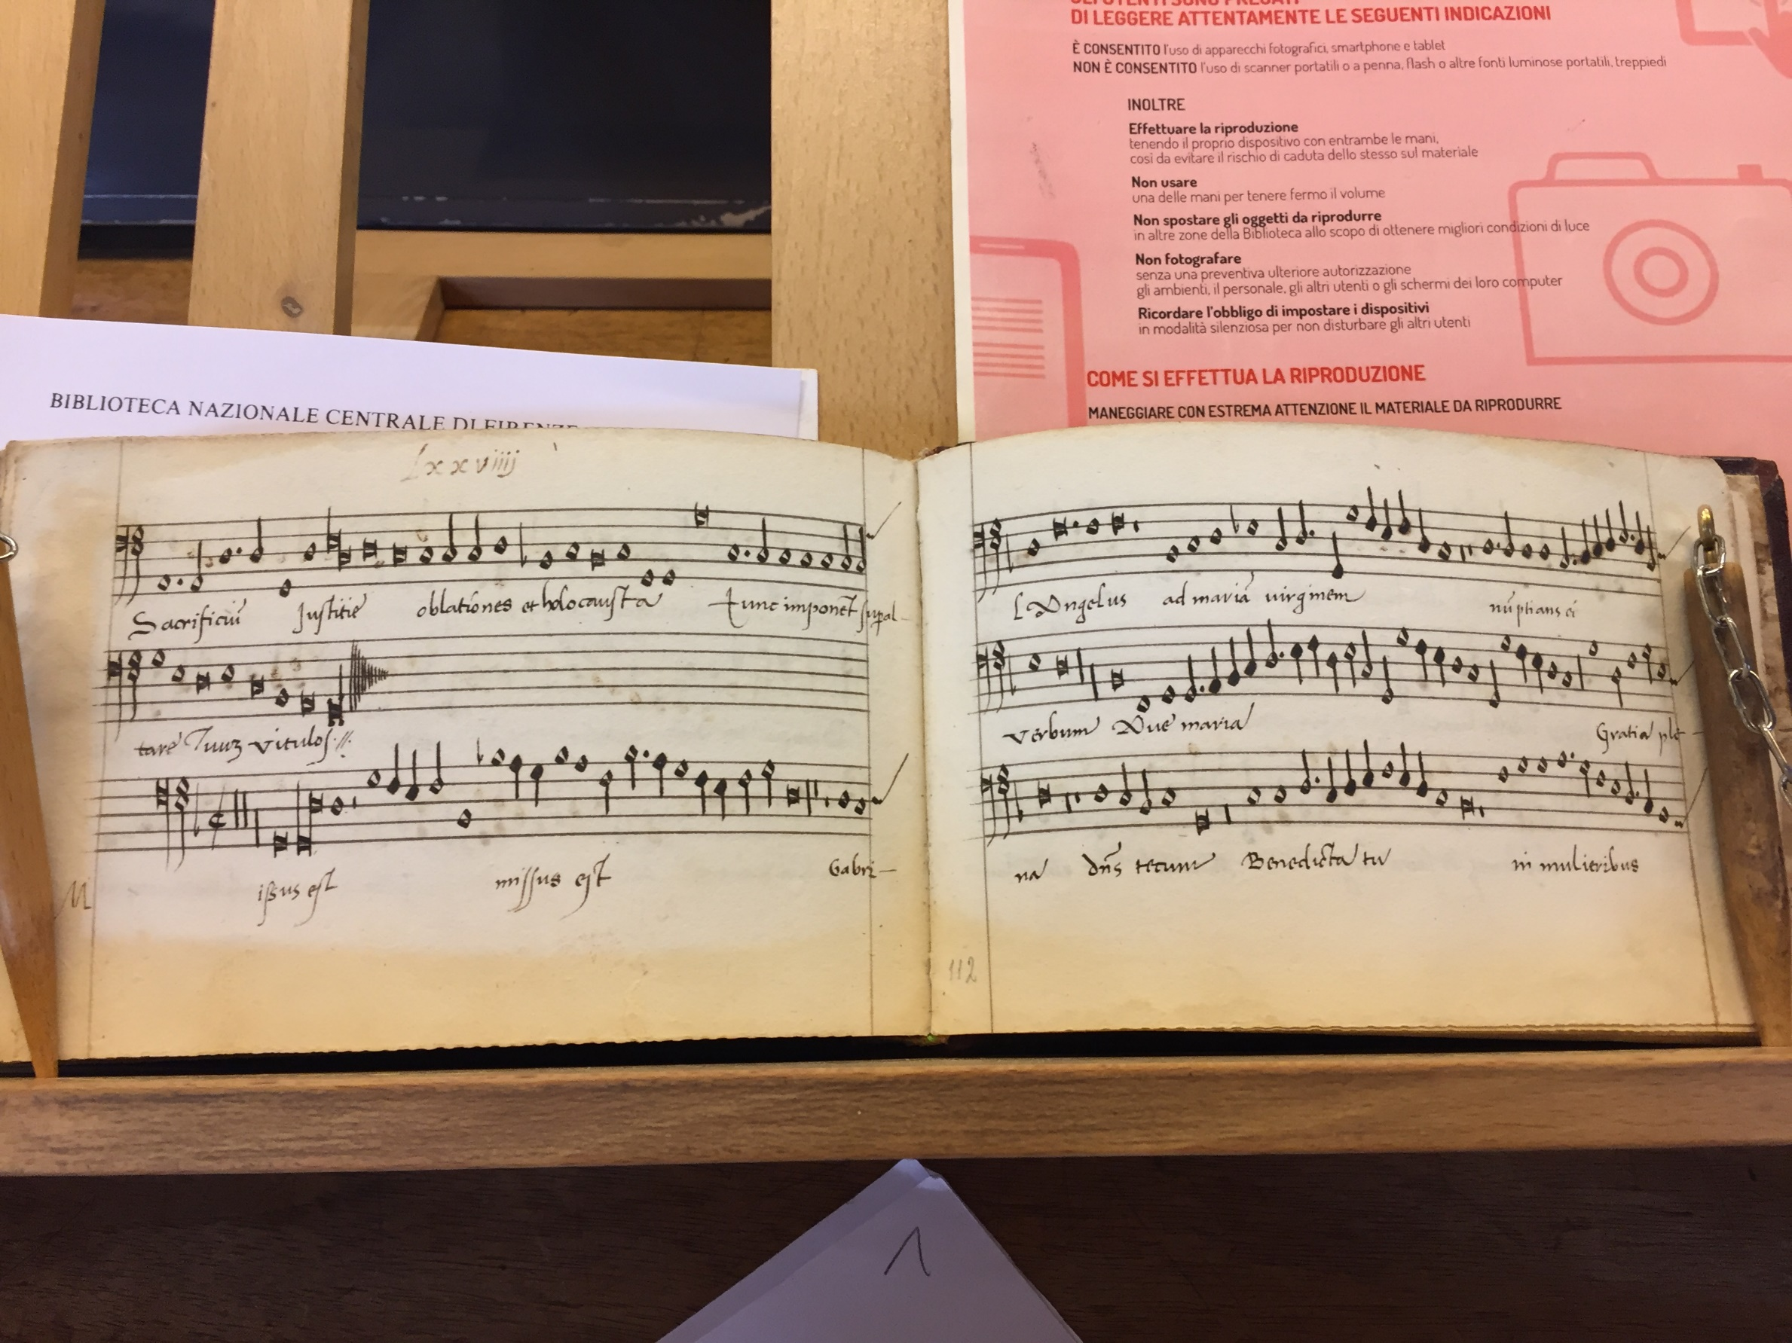
Motet by Josquin Desprez, Missus est Gabriel angelus
(no. 79)
Cantus and Bassus partbooks
Florence, BNC, Magl. XIX 164-167

Slide 54
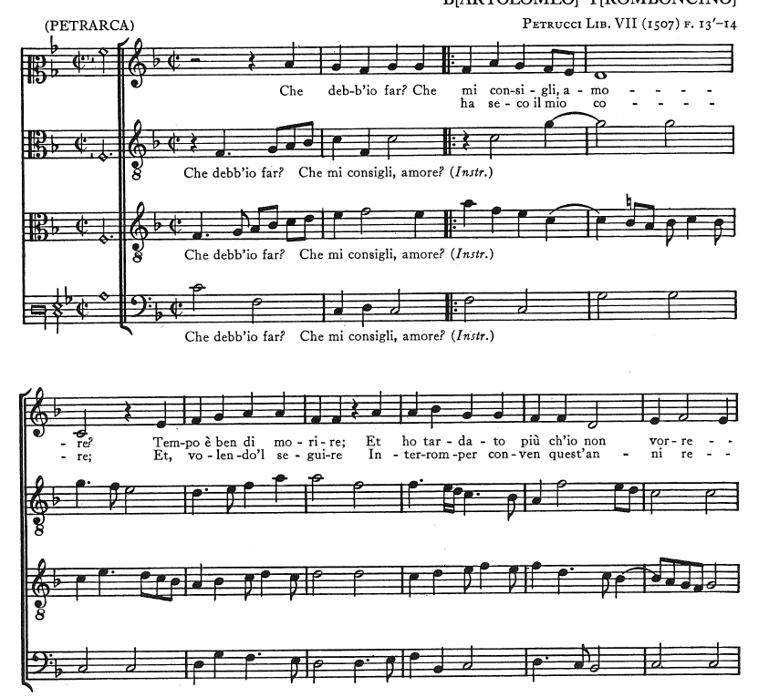
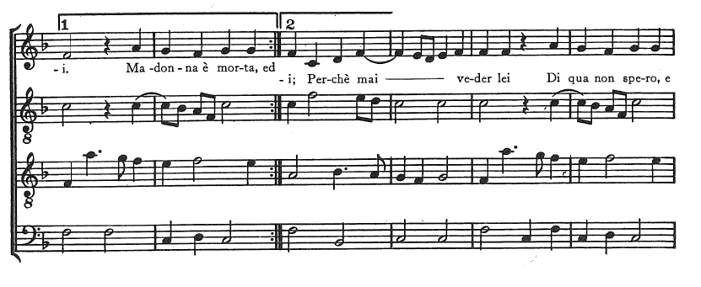
a
‘
a b
Frottola by Tromboncino, Che debb’io far (F164, no. 36)
Ruffled homophony
Schematic repetition (aab)
Text fits in top voice only
Repeated notes in top voice

Slide 55
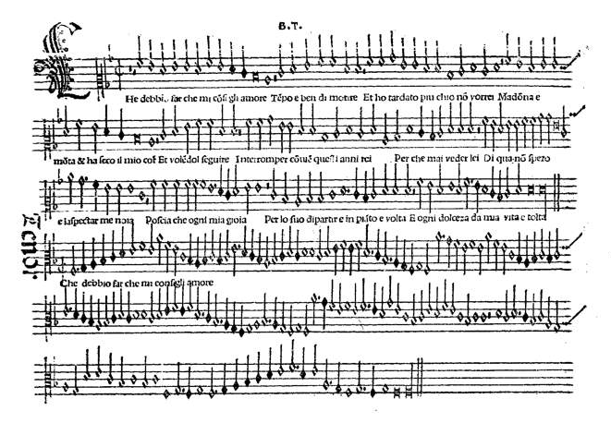
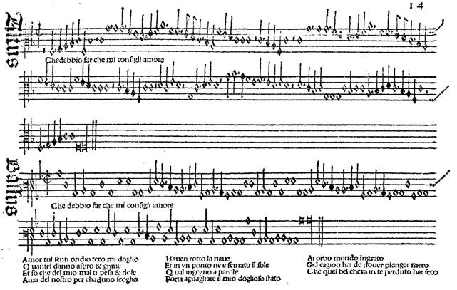
Frottola in small choirbook format, one opening Petrucci, Frottole Libro Septimo, Venice 1507
Bartolomeo Tromboncino, Che debbio far (ff. 13v-14r); canzona by Petrarch; second stanza below Bassus
http://daten.digitale-sammlungen.de/~db/0006/bsb00067024/images/index.html?id=00067024&groesser=&fip=yztsxdsydxdsydxdsydewqeayawyztseayaweaya&no=42&seite=26

Slide 56
Pesenti, Villotta, Quando lo pomo (quotes “O traditora”); Florence 164, no. 32 Imitation and homorhythm; repeated notes; cites popular song in Tenor
Petrucci Frottole XI (1514)
Antico Frottole II (1516 or 1520)
Florence 230, 337, and 2440
Venice 10653-6

Slide 57
Petrarca, no. 268, first stanza of canzone Che debb’io far? che mi consigli, Amore?
Set as both Frottola (with schematic repetition) and Madrigal (without repetition)
Che debb'io far, che mi consigli, Amore?
Tempo è ben di morire
ed ò tardato piú ch' i' non vorrei:
Madonna è morta ed à seco il mio core,
e volendol seguire
interromper conven quest' anni rei;
perché mai veder lei
di qua non spero, e l' aspettar m' è noia:
poscia ch' ogni mia gioia
per lo suo dipartire in pianto è volta,
ogni dolcezza de mia vita è tolta.
a
a
b
What must I do? What do you counsel, Love?
The time has truly come to die,
and I have lingered longer than I wish.
My lady is dead, and my heart with her:
and if I wish to follow,
I must interrupt this cruel life,
since I have no more hope
of seeing her here, and waiting galls me.
Now all my joy
has turned to weeping at her going,
all sweetness has been taken from my life.

Slide 58
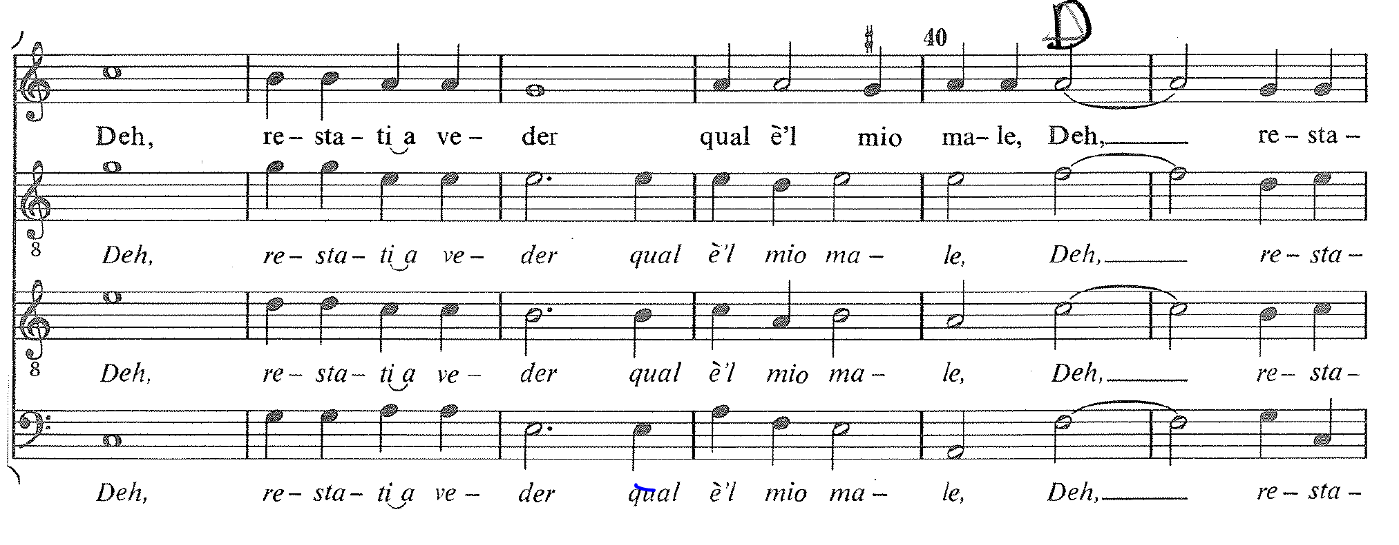
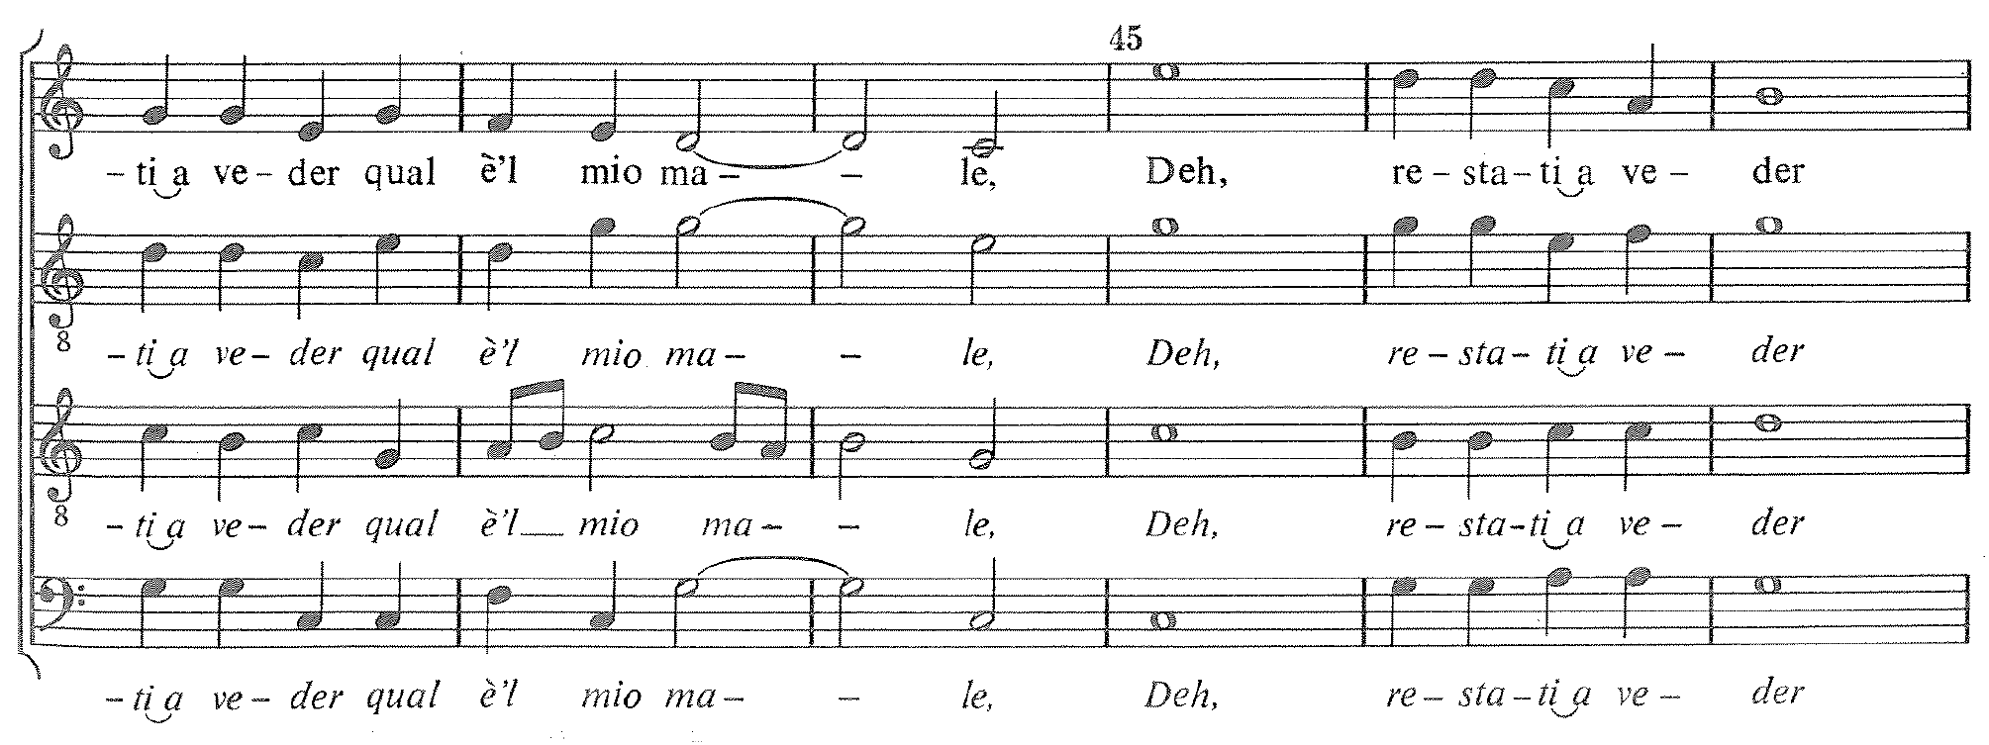
Sebastiano Festa, O passi sparsi (Petrarch), last line (4 times)
Found in 23 sources, until 1573. Used as the model for Masses by Lassus and Sermisy.
Deh, restate a veder qual è ’l mio male.
Ah, stay and see how great my suffering is.
All homorhythm, but also very expressive
F164, no. 25

Slide 59
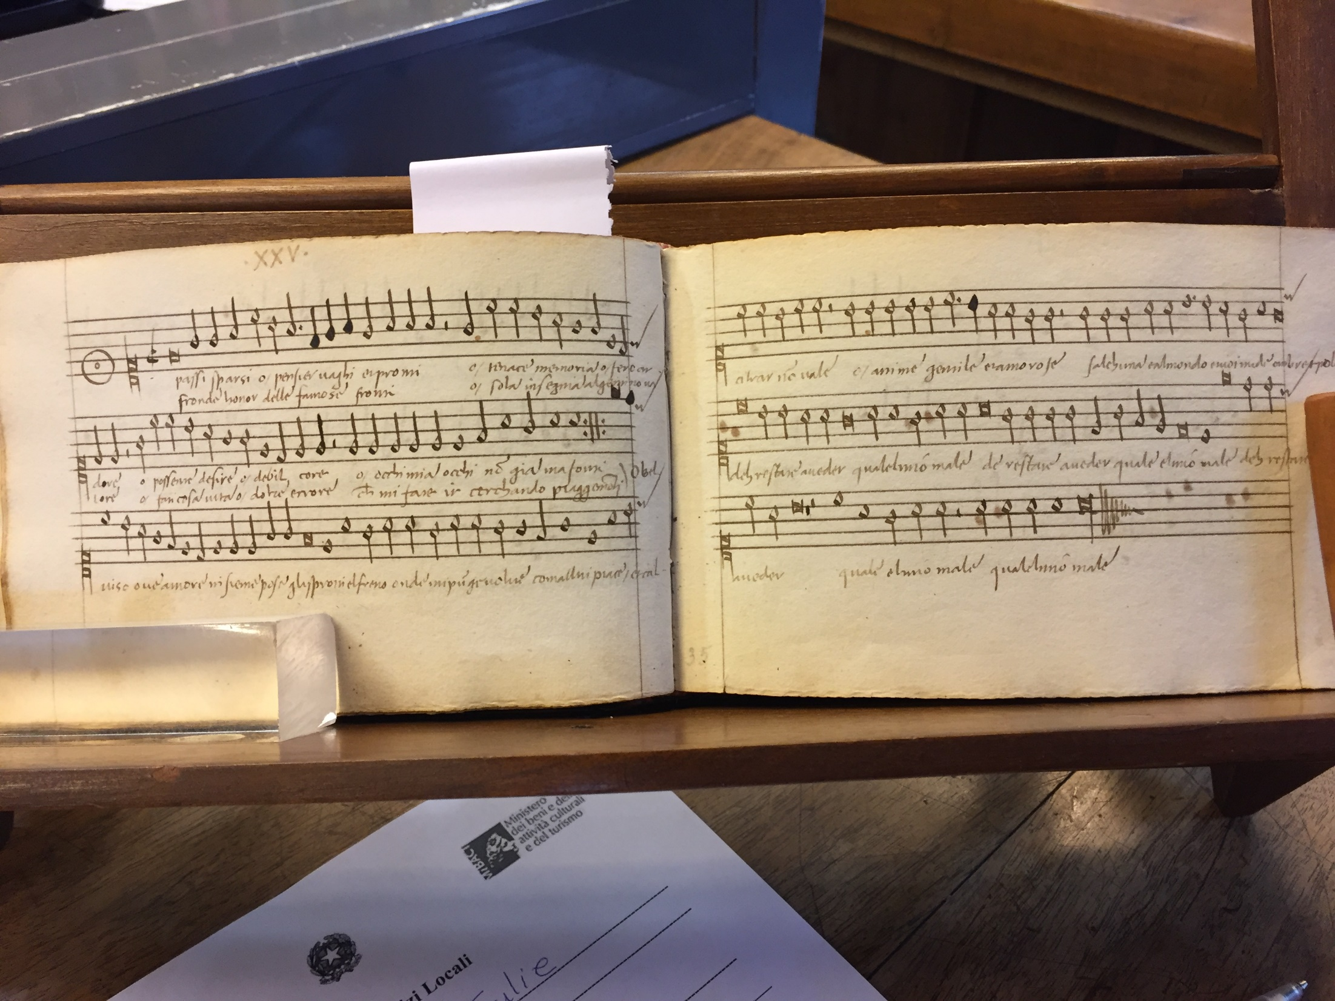
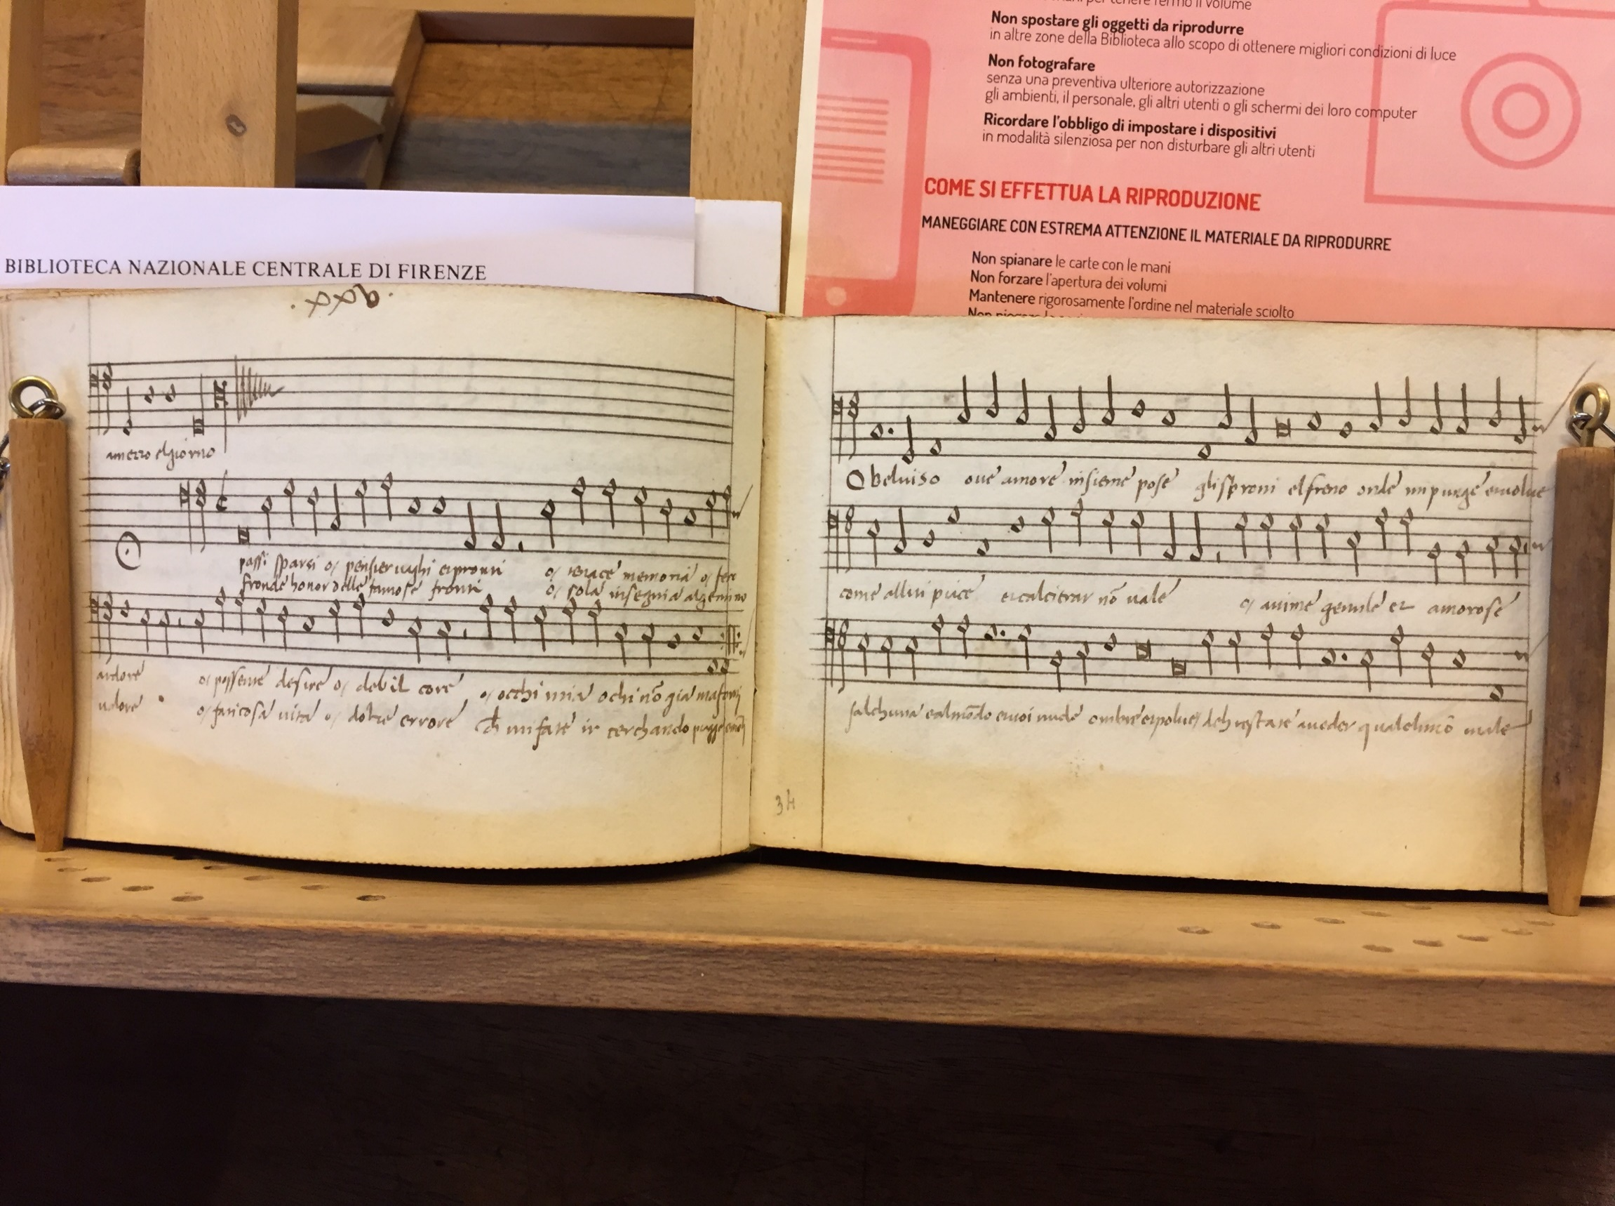
Madrigal by S. Festa, O passi sparsi (canzona by Petrarca) in the same small Soprano and Bass partbooks
Florence, BNC, Magl. XIX 164-167, no. 25.

Slide 60
Genre and musical style
Musical genres of vocal music are characterized by
Text types
and
Features of musical style, including
Form
Melody and text-setting
Texture
Counterpoint
Length

